Slide 1
Introduction to Machine Learning
Final Project Announcement
Presenter: TA Jui-Che (Ben)
Lastest update: 2023/12/05 16:30
Notes:
‹#›

Slide 2
Final Project
Deadline: 23:59, Jan. 5th (Fri), 2024
Performance (60%)
Participate in a Kaggle competition and optimize your model's performance to achieve the highest possible results.
Report (40%)
Provide a detailed description of your research process and implementation in the report.
Notes:
First of all, the deadline of the final project is set for Janurary 5th.
It consists of two section: performance and report with 60 and 40 points respectively.
For the performance section, you have to participate in a Kaggle competition and optimize your model's performance to achieve the highest possible results.
For the report section, you have to provide a detailed description of your research process and implementation.

Slide 3
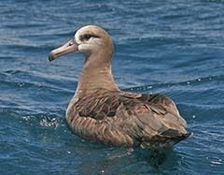
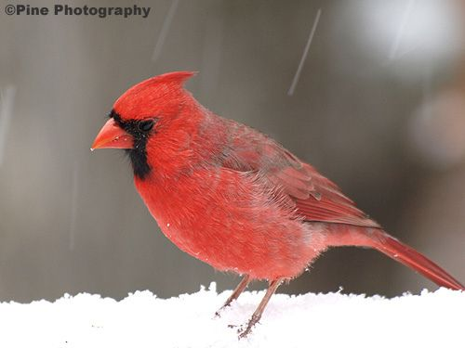
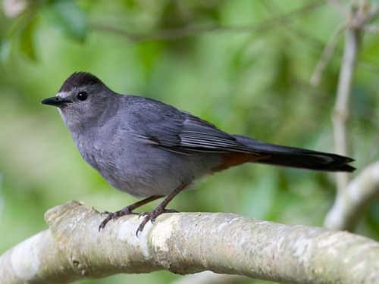
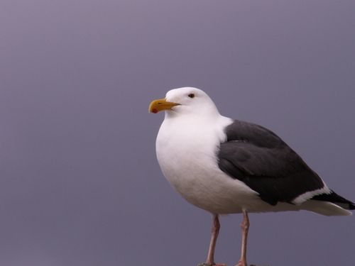
Bird Recognition Competition
Your Model
Black_ footed_Albatross
Cardinal
Gray_Catbird
California_Gull
Notes:
You are going to solve a bird recognition problem, and participate in a competition with your classmates.
The dataset contains images of different bird species. Your objective is to train a model to categorize and classify these birds using the provided images.

Slide 4
Tips
Fine-Grained Image Classification
A task in computer vision where the goal is to classify images into subcategories within a larger category.
You can find numerous resources on the internet!
Notes:
For this Bird recognition task, it’s is called Fine-Grained Image Classification, which is a task in computer vision where the goal is to classify images into subcategories within a larger category.
You can find numeruous resources on the internet with this keyword.

Slide 5
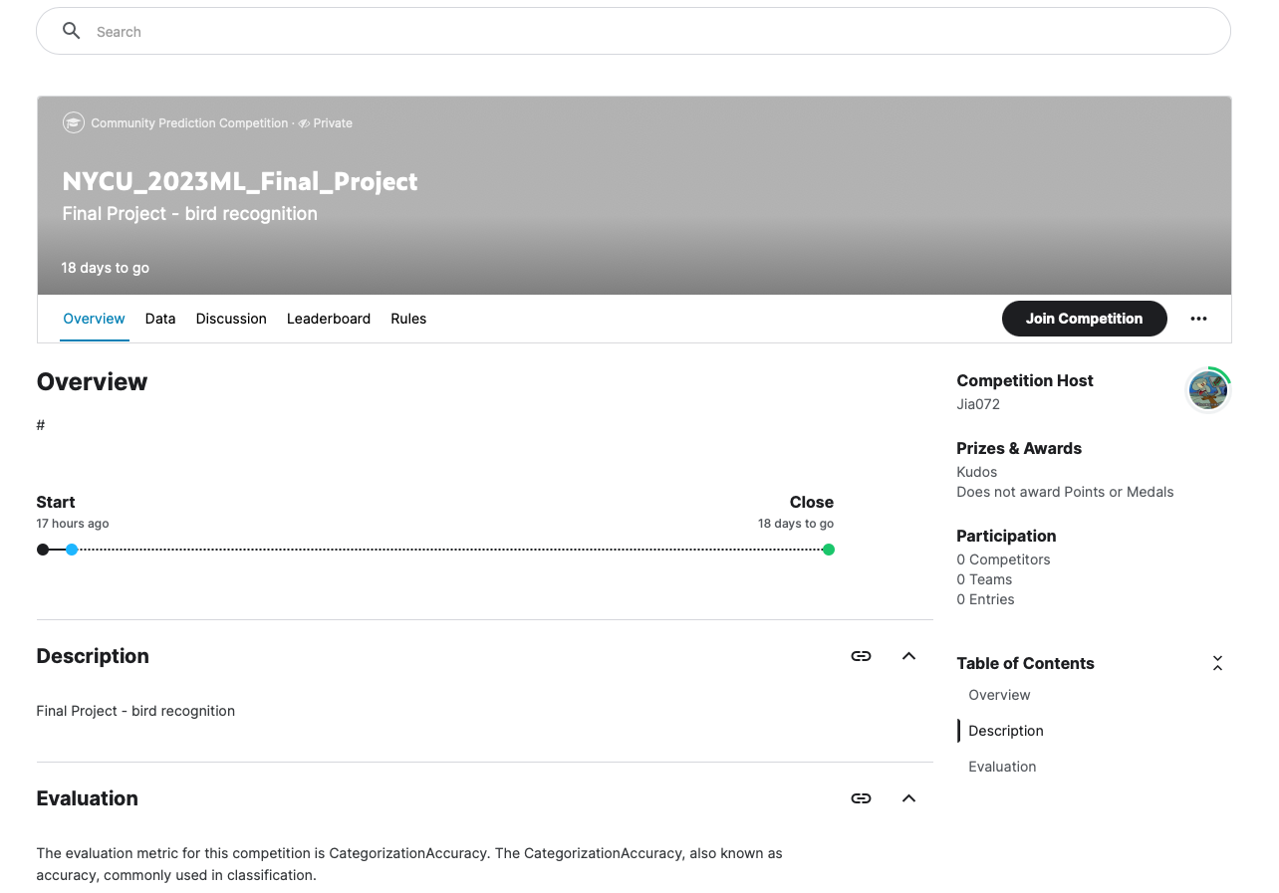
Join the Competition
Link

Slide 6
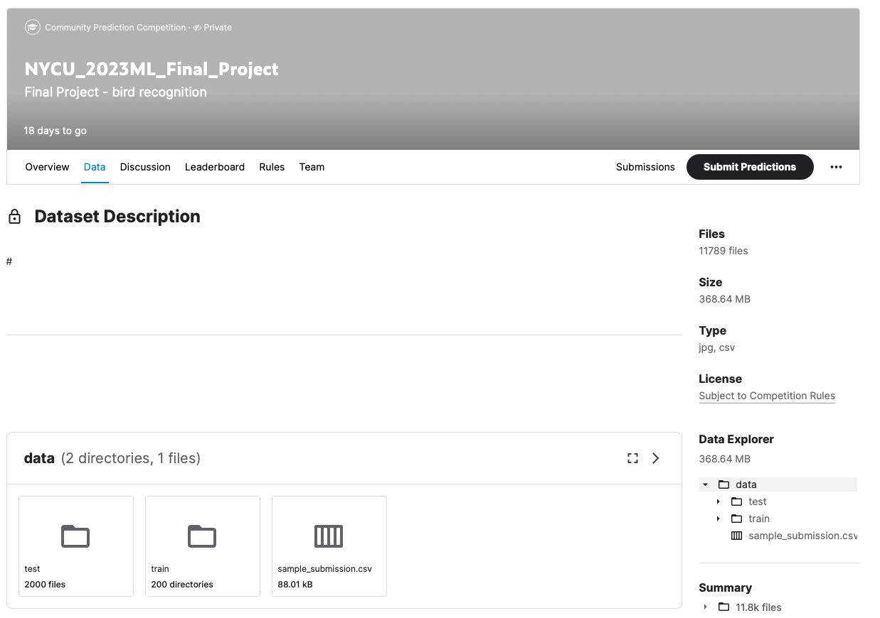
Download the Dataset

Slide 7
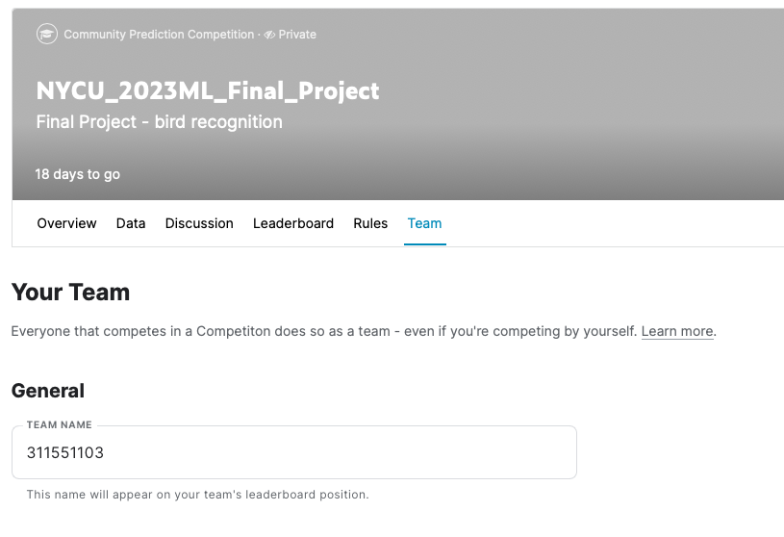
Set the Team Name
You must set your team name as your student ID.

Slide 8
Competition Rules
You are allowed to use any open-source resources/libraries but you must specify them in the report.
model architecture (ex: ResNet, ViT, etc. )
pre-trained weights (ex: ImageNet)
The only rule is that you have to train (finetune) your model by yourself!
Do not use model weights which are trained for image fine-grained classification (bird recognition).

Slide 9
Framework
PyTorch (Quick Start)
Keras
Tensorflow
Notes:
For this fine-grained image classification task, using deep learning methods is not only feasible but also recommended. There are three primary frameworks for implementing deep learning methods: PyTorch, Keras, and TensorFlow. While you have the flexibility to choose any of these frameworks, we highly encourage the use of PyTorch, as it is the most commonly employed framework in the academia.

Slide 10
Environment
Python version: 3.8 or newer
If you have a GPU:
Conda
Miniconda
virtualenv
If you don’t have a GPU:
Google Colab

Slide 11
Grading Criteria – Performance (60%)
Public leaderboard
For your reference
Private leaderboard
(45%) Baseline: accuracy >= 0.75
(15%) Compete with your classmates
accuracy
0
0.75
best accuracy
point
0
45%
45%+15%
linear interpolation
linear interpolation
Notes:
For the performance section, the grading criteria involve the use of a public leaderboard on Kaggle, which displays your and others' scores. However, It's crucial to note that the public leaderboard only serves as a reference, the actual grading will be determined based on the private leaderboard. Of course, the data of the two subset has similar distribution.
The grading scale is as follows: a baseline accuracy of 0.75 is set, and meeting this baseline earns you 45 points. The remaining 15 points is based on a competition within the class—your model must surpass the performance of every other student to secure full points. Points within these interval will be calculated using linear interpolation.

Slide 12
Grading Criteria – Report (40%)
Environment details (5%)
Python version
Framework
Hardware
Implementation details (15%)
Model architecture
Hyperparameters
Training strategy
Experimental results (15%)
Evaluation metrics
Learning curve
Ablation Study
Bonus (5%)
Such as comparisons, clear plots, methods/papers review and discussion, etc.
Notes:
In the report section, you are required to provide essential details, contributing to a total of 35 points. This includes information on the environment, implementation, and experimental results.
For the environment, you mush provide detailed information about the python version, the framework and the hardware you used.
For the implementation, you must provide detailed information about the architecture of your model, the hyperparameter you choose and your training strategy.
For the experimental result, you must provide some evaluation metrics, the learning curve and Ablation study.
Additional details that go beyond the specified requirements and contribute to the overall richness of your report will earn you bonus 5 points. This could include comparisons with different design, clear plots, methods/papers review and discussion, etc.

Slide 13
Submission
Zip all of the following files/directories into <STUDENT_ID>_final .zip and submit it to E3.
Training code
Place all of your training code in the ./training/ directory.
Inference code
<STUDENT_ID>_inference.ipynb/.py
Report
<STUDENT_ID>_report.pdf
Model weight
<STUDENT ID>_weight.txt
Provide a cloud drive link to your model weights & ensure access permissions are granted.
Environmental setting
requirements.txt (if you are using .py files)

Slide 14
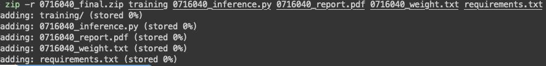
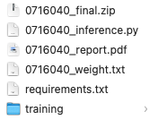
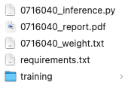
Submission
submit to E3
zip

Slide 15
Kaggle Submission Reproduction
Your inference file should be able to reproduce your kaggle submission.
You will load the model in your inference file (with the model weights you provide) and then generate your kaggle submission file.
For python file (inference.py)
It will be checked on our lab’s servers. (NVidia 2080Ti, cuda 11.3)
Please provide a requirements.txt file which can help us quickly rebuild your environment and accurately reproduce your results. (see tutorial)
For jupyter notebook file (inference.ipynb)
It will be checked on Google Colab.
Please include the necessary pip install instructions in the first cell.

Slide 16
Notes
Kaggle Submission Reproduction Failure
No points will be given for your performance part (60%).
Plagiarism
No points will be given for the entire assignment.
Late policy
There is no late submission policy for the final project. No points will be given if you submit your final project late.

Slide 17
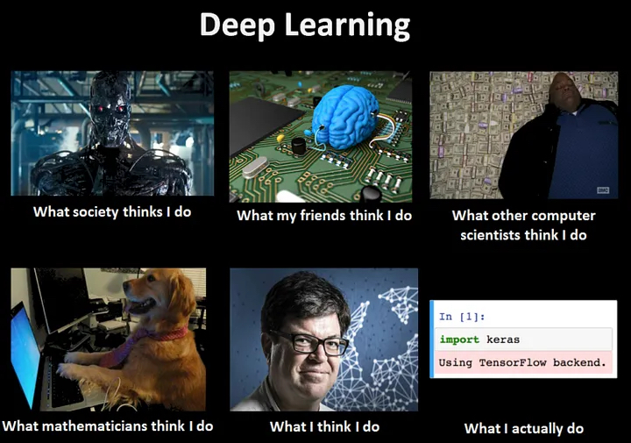
Have Fun
https://medium.datadriveninvestor.com/artificial-neural-networks-explained-to-5-year-old-5ceb532c11cc

